Slide 1
Media Decoding
Across the Curriculum

Slide 2
Media Decoding Across the Curriculum
We can give our students essential
habits of critical thinking by asking
key questions about all media messages
- that teach core content,
engage and empower.
Driven by: Inquiry, Standards, & Meaning Making

Slide 3
Why Integrate Media Literacy into Your Curriculum?
Notes:
3

Slide 5
Which questions are the most important,
and why?

Slide 6
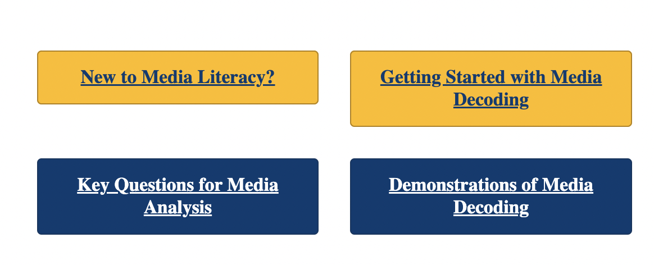
Dozens of short annotated video demonstrations of classroom media decoding for diverse levels and subjects

Slide 7
Pair Share:
What did you notice about
this way of teaching?
Notes:
7

Slide 8
Constructivist Media Decoding
Inquiry-based literacy process in which a teacher leads students through:
a collective reading
applying knowledge
interpreting and evaluating diverse media documents
Notes:
8

Slide 9
Constructivist Media Decoding
Inquiry-based literacy process in which a teacher leads students through:
a collective reading
applying knowledge
interpreting and evaluating diverse media documents
Notes:
9

Slide 10
Constructivist Media Decoding
Inquiry-based literacy process in which a teacher leads students through:
a collective reading
applying knowledge
interpreting and evaluating diverse media documents
Notes:
10

Slide 11
Constructivist Media Decoding
Inquiry-based literacy process in which a teacher leads students through:
a collective reading
applying knowledge
interpreting and evaluating diverse media documents
Notes:
11

Slide 12
Constructivist Media Decoding
Inquiry-based literacy process in which a teacher leads students through:
a collective reading
applying knowledge
interpreting and evaluating diverse media documents
Notes:
12

Slide 13
Constructivist Media Decoding
Inquiry-based literacy process in which a teacher leads students through:
a collective reading
applying knowledge
interpreting and evaluating diverse media documents
Notes:
13

Slide 14
Constructivist Media Decoding
Inquiry-based literacy process in which a teacher leads students through:
a collective reading
applying knowledge
interpreting and evaluating diverse media documents
Notes:
14

Slide 15
Constructivist Media Decoding
Inquiry-based literacy process in which a teacher leads students through:
a collective reading
applying knowledge
interpreting and evaluating diverse media documents
Notes:
15

Slide 19
Survey for Media Decoding Support
Name____________________________ Date____________
Which of your upcoming unit(s) would lend itself to the integration of media decoding?
When do you plan on teaching this unit(s)?
Would you like recommendations for media decoding lesson(s) for this unit? Yes No
Would you like to collaborate on planning and implementing a decoding? Yes No
Check any challenges you anticipate in this work:
____ Time in the curriculum ____ Alignment with my content and standards
____ Time for collaboration ____ This approach working with my students
OTHER: I will review your comments and get back to you.
Notes:
19

Slide 20
Media Decoding Across the Curriculum
www.projectlooksharp.org
Driven by: Inquiry, Standards, & Meaning Making

